Slide 1

CSE 163
Dictionaries and Pandas
Hunter Schafer

Slide 2
Last Time
More Lists
Sets
Dictionaries
Tuples
This Time
More Dictionaries
CSVs
Pandas

Slide 3
Recap
Learned about 4 different data structures today!
List Has indices, this can be added/removed at any place
Set No duplicates, fast membership queries, no order
Dictionary Like a generic list that can have any value as keys Keys are unique, values are not
Tuple Immutable list, commonly used as returns, can “unpack”

Slide 4
Dictionary
Python has a data structure called a dictionary that allows us to use arbitrary data as indices (keys)
Dictionary Demo + Text Data Analysis Demo 2
Keys are unique, values are not
Basically a fancy list, most syntax is familiar
Will start Wed by going more in-depth with dictionaries
d = {}
d['a'] = 1
d['b'] = 2
print(d) # {'a': 1, 'b': 2}

Slide 5
Dictionary Methods
Dictionary Methods
dict() or {} | Makes an empty dictionary
d[key] | Gets the value for k, KeyError if None
d[key] = val | Assigns val as the value for key
d.pop(key) | Removes key from this dictionary
d.keys() | Returns a collection of the keys
d.values() | Returns a collection of the values
d.items() | Returns a collection of (key, value) tuples

Slide 6
Comma Separated Values
CSV
A file that encodes a spreadsheet. Separates cells w/ commas
If you were to save this as a CSV
Name | Salary
Erika | 3
Erik | 2
Josh | 4
Name,Salary
Erika,3
Erik,2
Josh,4

Slide 7
Processing CSVs
Well structured so they are easy to parse!
Not clear how to represent since we need info on rows and cols. Have to use multiple data structures!
Name,Salary
Erika,3
Erik,2
Josh,4
We will use a list of dictionaries to store this information
[
{'Name': 'Erika', 'Salary': '3'},
{'Name': 'Erik', 'Salary': '2'},
{'Name': 'Josh', 'Salary': '4'}
]

Slide 8
CSV Demo
CSV Demo
Just showed the code for parse because it’s not important to know how to write that code
Calculate the sum of TA Salaries
Work with earthquake data
id | year | month | day | latitude | longitude | name | magnitude
nc72666881 | 2016 | 7 | 27 | 37.6723333 | -121.619 | California | 1.43
... | ... | ... | ... | ... | ... | ... | ...

Slide 9
Brain Break

Slide 10
Processing CSVs
A bit tedious
Code to read from the file is complicated (probably wrong too)
Have to pay particular attention to do the types
The code to compute statistics isn’t too bad, but still have to write a bit
If only there were a better way!

Slide 11
Pandas
A library is a packaged version of someone else’s code
Pandas is a library that makes it super easy to work with CSVs
To start, you can have pandas read the CSV for you
import pandas
data = pandas.read_csv('earthquakes.csv')
import pandas as pd
data = pd.read_csv('earthquakes.csv')

Slide 12
DataFrame
One of the basic data types from pandas is a DataFrame
It’s essentially a table with column and rows!
Columns
 | id | year | month | day | latitude | longitude | name | magnitude
0 | nc72666881 | 2016 | 7 | 27 | 37.672333 | -121.619000 | California | 1.43
1 | us20006i0y | 2016 | 7 | 27 | 21.514600 | 94.572100 | Burma | 4.90
2 | nc72666891 | 2016 | 7 | 27 | 37.576500 | -118.859167 | California | 0.06
Index (row)

Slide 13
Series
A Series is like a 1-dimensional DataFrame (no columns!)
Has an index
It’s basically like a fancy dictionary/list hybrid
For example
data['name']
0 | California
1 | Burma
2 | California
data['name'][1] # 'Burma'

Slide 14
Series Methods
Series has a many methods that help you process your data
mean
min
max
idxmin
idxmax
count
unique
And many many more!
Element-wise operators
Arithmetic: +, -, *, /, etc.
Comparison: <, >, ==

Slide 15
Filtering
Can use a bool Series to select which rows from the dataset
Can use multiple filters with: & (and), | (or), ~ (not)
mask = data['magnitude'] > 5
data[mask]
# Same as: data[data['magnitude'] > 5]
 | id | year | month | day | latitude | longitude | name | magnitude
30 | us20006i18 | 2016 | 7 | 27 | -24.286000 | -67.864700 | Chile | 5.60
114 | us20006i35 | 2016 | 7 | 27 | 36.492200 | 140.756800 | Japan | 5.30
421 | us1000683b | 2016 | 7 | 28 | -16.824200 | -172.515800 | Tonga | 5.10
data[(data['magnitude'] > 5) & ~(data['day'] == 27)]

Slide 16
Location Location Location
When working with pandas, you have to think about
How do I get to the data I want?
Want computation do I want to do on that data?
Very experimental, highly recommend using a Jupyter Notebook to try different things to see how to get the data
So far, we have shown you how to access columns and filter
These are special syntax for a more general method of accessing data
Location Demo
data.loc[<row indexer>, <column indexer>]

Slide 17
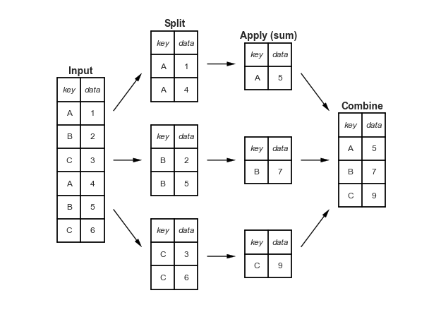
Group By
groupby lets you group and aggregate your data
We will cover this more on Friday!

